Slide 1
Fertility Developments in Europe: Between Uncertainty and Policy Interventions
Agnieszka Chłoń-Domińczak
KIPF/HAPI Conference Fiscal and Tax Reform: Policy Responses for Low Fertility and Aging Society
Honolulu, 18 April 2024

Slide 2
Outline
Fertility developments in Europe
Determinants of low fertility
Shocks and fertility responses
Policies to suport fertility decisions
Building fertility resilience

Slide 3
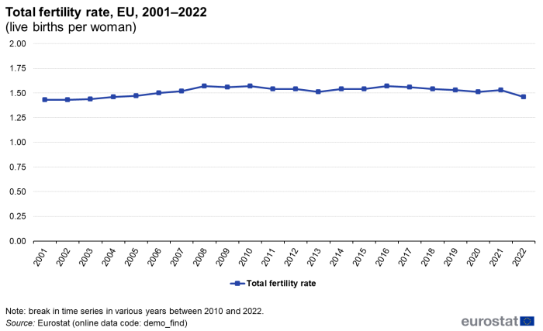
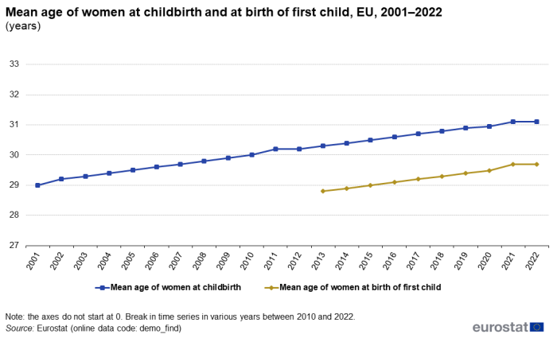
Total fertility in the EU is below replacement level and the mean age at childbirth is rising…

Slide 4
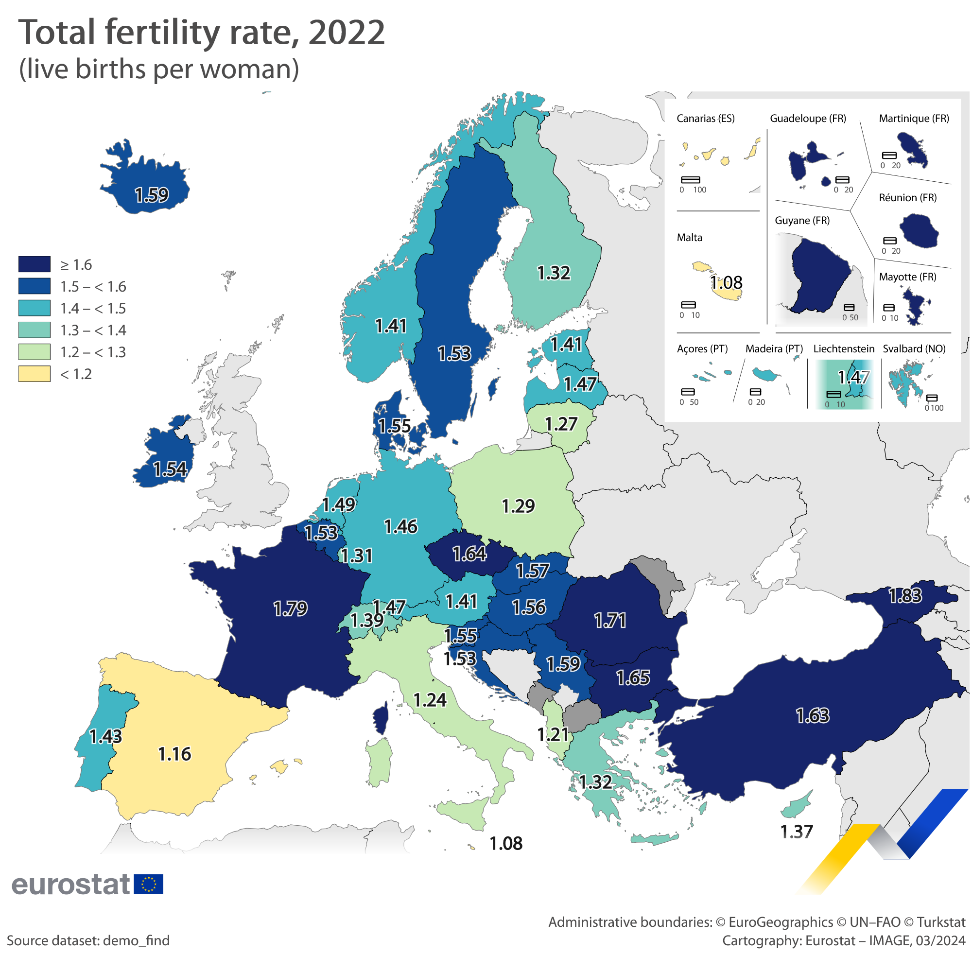
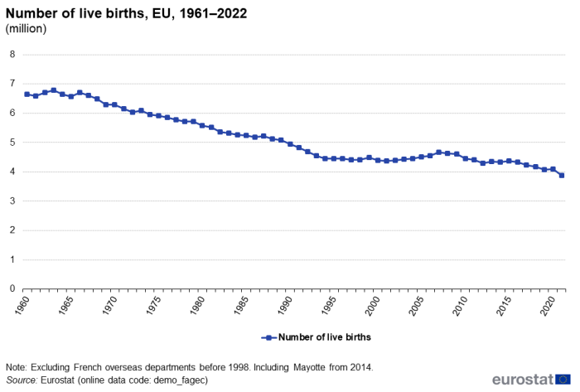
The numer of life births halved between 1960s and now, with significant country differences in TFR

Slide 5
TFR changes in the EU 2007-2021
Decline in TFR observed in countries with highest TFR in 2007 (Fi, SE, IE)
Some increases in countries with lowest levels (SK, HU)
Source: Chłoń-Domińczak et al. (2024)

Slide 6
Determinants of low fertility
Ideational change and the Second Demographic Transition
from traditional norms, duties and ideologies associated with the family to “postmaterialist values”
dismissal of institutional control, individual self fulfillment, the importance of lifestyle and personal freedom
delay of marriage, its displacement by cohabitation, increased union instability
rise in extramarital births, emergence of sub-replacement fertility preferences
Postponment of childbearing
“postponement transition” supported by the diffusion of reliable methods of contraception
reduced the rates of unwanted and unplanned pregnancies and births
increase in voluntary childlessness
Source: Wilkins (2019)

Slide 7
Determinants of low fertility
Economic constraints
Economic and labor market uncertainty
Direct economic costs of raising children
Housing
Education
Combining work and childbearing
opportunity cost of having children
Gender inequity in the domestic sphere
Workplace conditions and policies and parental leave policies
Availability of childcare policies
Source: Wilkins (2019)

Slide 8
Shocks and fertility
Recession
recessions were associated with fertility declines and postponement of childbearing decisions
The fertility decline was more pronounced in countries and regions that experienced stronger economic downturns and faster increases in unemployment
postponement effect has been particularly strong among childless women
COVID-19 pandemic
pandemics coincides with a significant decrease in monthly fertility rates
increasing social and economic uncertainty, changes in work-life balance
limited access to health care and assisted reproductive technologies
lowered sense of financial security and worse mental well-being
Source: Chłoń-Domińczak et al. (2024)

Slide 9
Six main aims of policies supporting families
Poverty reduction and income maintenance through allocation of benefits to lower-income families
Direct compensation for the economic cost of children through allocation of cash benefits, fiscal transfers
Fostering employment, especially among mothers: parental leave, childcare provision, part-time and flexible working time
Improving gender equality: promoting equal sharing of paid and unpaid work, including childcare, between partners
Support for early childhood development
Increasing birth rates
Source: Sobotka, Matysiak, Brzozowska (2019)

Slide 10
Different approaches to family policies
The Nordic countries
continuous and strong support for working parents with small children and for fathers’ involvement in care
Continental European countries
family support relatively high, mostly related to supporting traditional division of labor
providing financial support to families with children,
gradual shift towards a stronger support of women’s employment and work-family reconciliation
Source: Sobotka, Matysiak, Brzozowska (2019)

Slide 11
Different approaches to family policies
Anglo-Saxon countries
support especially via cash benefits, targeting low-income families
Southern Europe countries
more limited policies,
shorter period of paid childcare leave,
limited cash transfers to families
lower provision of public childcare
Central-Eastern European countries
family policies undergoing reforms and changes in different directions
Underdeveloped policies supporting a combination of motherhood and paid employment
explicitly support familialism: limited childcare for children below age 3 and creating extensive parental leave programs (Czechia, Hungary
providing little support for families at all (Poland and Slovakia)
family policies in Slovenia, Estonia, and Lithuania support work and family reconciliation and more extensive early childcare provision
Source: Sobotka, Matysiak, Brzozowska (2019)

Slide 12
Policy directions
Major and comprehensive expansion of family policies:
a broad array of measures including financial benefits, and support for larger families,
measures supporting childcare provision, mothers’ employment
more flexibility in combining work career and parenthood
Shift towards supporting parents’ employment and the combination of career and family life
new policies that address the employment-family conflict among parents, especially mothers
Policy expansion centered on cash benefits
countries in Central, Eastern and South-eastern Europe, whose governments have embraced pronatalist rhetoric and interventions.
Source: Sobotka, Matysiak, Brzozowska (2019)

Slide 13
Correlation between spending on family policies in 2013, Total Fertility Rate in 2014 and completed fertility rate (CTFR) among women born in 1976
Source: Sobotka, Matysiak, Brzozowska (2019)

Slide 14
Extension of parental leave: Sweden
In response to worsening labor market prospects, Swedes tended to postpone first and further births until more favorable economic (and financial) conditions.
Limits of the ‘speed premium’ policy in boosting fertility
Procyclical nature of the effects of Swedish parental leave benefit on fertility
Leave benefits that are linked to the past wage, often tend to accelerate childbearing in the more prosperous times and suppress it in times of economic downturns
Source: Sobotka, Matysiak, Brzozowska (2019)

Slide 15
Designing comprehensive, universal and generous parental leave: the case of Estonia
Expansion of generous parental leave
More flexible, easier to combine with continuing employment and to increase fathers’ involvement in the leave
Public childcare provision gradually increased
Period TFR showed a continued increase after the leave expansion
Tempo- and Parity-adjusted Total Fertility increased only slightly after 2003 and cohort fertility rates have broadly stabilized
Source: Sobotka, Matysiak, Brzozowska (2019)

Slide 16
Childcare
The provision of public childcare consistently shows positive effects on completed fertility and its effects are largest for the highly educated women.
Childcare provision is most likely to bring positive effects if:
It is of high quality
It is available for children of all ages, including young children below age 3, and school-aged children
Its opening hours are flexible and aligned to parents’ working hours
It is affordable
Childcare and TFR in Germany
Source: Sobotka, Matysiak, Brzozowska (2019)

Slide 17
Parental leaves
The effects of parental leave schemes are rather inconsistent,
huge diversity in parental leave entitlements, I
leave duration,
flexibility and options of sharing it between the parents, level
universality of leave benefit,
entitlement conditions
Parental leaves are most likely to bring positive effects on fertility if they are well paid.
Source: Sobotka, Matysiak, Brzozowska (2019)

Slide 18
Parental leave flexibility
Parents in Czechia receive leave allowance of an equivalent of EUR 11,600 that can be distributed in monthly instalments during their parental leave over the period of 7 to 48 months (the longer the leave, the lower the monthly payment with cap)
In Austria parents can draw a total benefit of around EUR 15,500 over the period of 14 and 35 months. The leave regulations provide an incentive for both parents to share the leave in order to boost the participation of fathers.
Germany offers a possibility of returning to part-time employment during the parental leave and keeping the right to part-time parental leave benefit.
Finland and Norway, where maternity and parental leave benefits are paid for about one year and are strongly income dependent, offer in addition flat-rate cash payments to parents who wish to stay longer at home with their child
Source: Sobotka, Matysiak, Brzozowska (2019)

Slide 19
Other policies
Financial incentives often show positive effect on fertility, but their long-term impact on completed fertility is less obvious: when it is demonstrated, it is rather small and impacting mainly lower-educated and lower-income groups
Subsidized and widely accessible provision of assisted reproduction has a small positive effect on fertility rates. Wider societal and cultural acceptance of AR, typical of Israel or the Nordic countries, is also linked with its higher use among infertile couples
Source: Sobotka, Matysiak, Brzozowska (2019)

Slide 20
European normative resources supporting family policies
The work-life balance directive
a potential to increase the role of fathers in care,
enhancing possibilities for mothers to retain and strengthen their link to the labour market
Directive on pay transparency
expected to be a substantial step forward to the achievement of the objective of equal pay for men and women and promoting gender balance
Source: Magda and Chłoń-Domińczak (2024)

Slide 21
What makes family policies (un)successful
Policy instability and fiscal sustainability
reversals of family policies make them unpredictable, unreliable and confusing, potentially having a negative impact on fertility
Explicit fertility policies might not be the most influential ones
Countries where young women and men experience considerable economic uncertainty, as has been the case in the last decade in Southern Europe, are unlikely to see large fertility upturns even if they embark on a substantial expansion of their family policies.
reversing fertility declines may require much wider institutional reform, dealing with labor market rules and culture, education institutions and gender inequalities
Source: Sobotka, Matysiak, Brzozowska (2019)

Slide 22
What makes family policies (un)successful
Policy (in)compatibility
the package might not be well balanced as the policies in place result from a long history of initiatives, reforms and changes, which were often introduced by different ministries or responsible bodies without much coordination.
Policy (mis)targeting
family policies vary by the number or birth order of children in the family, when first children are needed
misaligned with the perceived obstacles and barriers to childbearing among prospective parents (ignoring unmarried couples, single parents..)
Ethical considerations: Family policy reflecting family diversity and reproductive rights
Source: Sobotka, Matysiak, Brzozowska (2019)

Slide 23
Policy recommendations to tackle low fertility
more equitable and inclusive employment options for young people
prevent employers discriminating against future parents when making recruitment decisions
challenge and shift gender norms concerning the domestic division of labor
tackling engrained socio-cultural norms
strong government dedication to penalize gender-biased sex selection and the enhancement of women’s social status
structural changes to address long and inflexible working hours
addressing structural constraints in the housing market
provision of universal, accessible, affordable, publicly-funded childcare services
stable and predictable family policies relating to childcare and parental leave
financial transfers to support childbearing
May speed-up childbearing decisions, but impact on the TFR is ambigious
all of these policies, covering education, housing, the labor market, economy and social welfare should be considered holistically to maximize compatibility across the different domains
Source: Sobotka, Matysiak, Brzozowska (2019)

Slide 24
Level | Disturbances | Life-course capital and resources | Outcomes
Macro | Climate change COVID-19 pandemic Economic crisis/ Recession Shift in social norms concerning parenthood | Comprehensive healthcare reproductive health services: pre-natal care, infertility diagnosis and access to ART Education: Well-developed ECEC and full-time schools parental leave policies Flexibility in terms of time and place to work ‘gender egalitarian’ policies Work-life balance policies | Macro-level fertility trends
Meso | Local labour markets Local governance and policies Natural disasters at the local level Shift in social norms concerning parenthood | Social networks: heteregenous and dense Social integration Local family policies Access to childcare Quality of educational institutions Family arrangements Kinship networks | Fertility-related behaviour at the family and societal levels
Micro | Job loss Health status/infertility risk Income instability Dissolution of partnership | Capital: economic, social, human and institutional: educational attainment, health status, household composition, household wealth, housing situation | Individual fertility behaviour
Source: Chłoń-Domińczak et al. (2024)

Slide 25
References
Chłoń-Domińczak, A. M.Chełchowska, W.Grzenda, I.E. Kotowska, K.Tymicki (2024), Resilience as theoretical foundation for fertility dynamics, Futures Working Paper D3.1
Magda, I., A.Chłoń-Domińczak (2024) Gender and European social rights and social citizenship, EuSocialCit WP2 report
Sobotka, T., A.Matysia, Z.Brzozowska (2019) Policy responses to low fertility: How effective are they? Working Paper No. 1, UNFPA Technical Division Working Paper Series Population & Development Branch
Wilkins, E. (2019) Low fertility: A review of the determinants, Working Paper No. 2, UNFPA Technical Division Working Paper Series Population & Development Branch

